Slide 1

MicroProfile GraphQL
Everything you ever wanted – and ONLY what you want!
Andy McCright – IBM Web Services Architect
@AndrewMcCright

Slide 2

What is MicroProfile?
MicroProfile 3.3
https://microprofile.io
Rest Client 1.4
Fault Tolerance 2.1
Health 2.2
Metrics 2.3
Open API 1.1
Open Tracing 1.3
JWT 1.1
Config 1.4
CDI 2.0
JAX-RS 2.1
JSON-B 1.0
JSON-P 1.1
Updated specs
Unchanged specs
Java EE specs
Notes:
MicroProfile (MP) is a community formed independently to close the gap between Java EE technologies and modern cloud-based application requirements. Founding members include IBM, Payara, RedHat, and Tomitribe. Today MP includes other sponsors such as LJC, SOUJava, Hazelcast, Fujitsu, kumuluz, Oracle, Hammock, Lightbend and MicroSoft.
MP builds on existing Java EE 8 technologies – specifically CDI, JAX-RS, JSON-P and JSON-B.
MP adds value with it’s own technologies, such as:
Config – enabling injection-based configuration of applications from sources such as system properties, environment variables, etc.
Rest Client – a popular type-safe approach for invoking RESTful services.
Health – a health check mechanism for environments like Kubernetes.
Metrics – an API for tracking stats of Java EE applications.
JWT – implementation of JSON Web Tokens for sharing authentication info between services.
Open Tracing – an industry standard in tracing requests through multiple services.
OpenAPI – an industry standard for documenting RESTful services.
Fault Tolerance – a set of annotation-based APIs allowing developers to easily add resilience without compromising maintainability.

Slide 3
What is GraphQL?
GraphQL is an open-source data query and manipulation language for APIs, and a runtime for fulfilling queries with existing data. GraphQL interprets strings from the client, and returns data in an understandable, predictable, pre-defined manner. GraphQL is an alternative, though not necessarily a replacement for REST.
GraphQL was developed internally by Facebook in 2012 before being publicly released in 2015. Facebook delivered both a specification and a reference implementation in JavaScript.
On 7 November 2018, Facebook moved the GraphQL project to the newly-established GraphQL foundation, hosted by the non-profit Linux Foundation. This is a significant milestone in terms of industry and community adoption. GraphQL is widely used by many customers.

Slide 4
What is GraphQL?
GraphQL enables clients to invoke queries (read) and mutations (create/update/delete) on entity types and specify which fields from the entity is returned.
GraphQL schemas allow developers to specify output types, input types, interfaces, and enumerated types.
GraphQL “primitives” are known as scalars. The spec defines that all GraphQL implementations handle String, Int, Float, Boolean, and ID. Implementations are allowed to define custom scalars.

Slide 5
Why GraphQL?
Avoiding over-fetching or under-fetching data. Clients can retrieve several types of data in a single request or can limit the response data based on specific criteria.
Enabling data models to evolve. The schema can change without requiring changes in existing clients, and vice versa - this can be done without a need for a new version of the application.
Partial results on errors.
The schema defines how the data can be accessed and serves as the contract between the client and the server. Development teams on both sides can work without further communication.
Native schema introspection enables users to discover APIs and to refine the queries on the client-side. This advantage is increased with graphical tools such as GraphiQL and GraphQL Voyager enabling smooth and easy API discovery.

Slide 6
What is MicroProfile GraphQL?
MP Community with many active participants (more are always welcome!) https://github.com/eclipse/microprofile-graphql https://gitter.im/eclipse/microprofile-graphql
Goal is a “code-first” approach to building GraphQL applications.
MP GraphQL API intends to borrow ideas from well-known APIs like JAX-RS.
Based around the GraphQL-SPQR project https://github.com/leangen/graphql-spqr

Slide 7
Sample App
Weather!!
This app will provide current conditions and forecast for various locations, similar to services offered by accuweather.com, weather.com, etc.
Unlike “real” weather stations, our data is generated at random.
At least at first, this sample app will function as the complete service. In the future, we could incorporate a micro-services approach using IoT-based weather stations, etc.

Slide 8
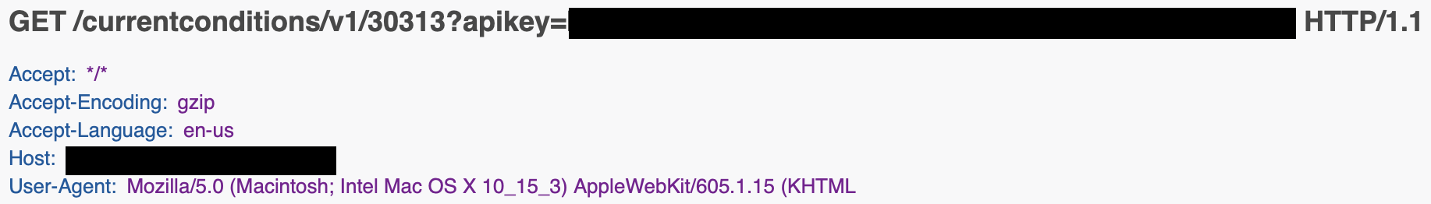
The Scenario: Local conditions
Our “portal” app would like to include a widget on the webpage that will show the current temperature and tell if it is raining, snowing, sunny, etc.
There are a few service providers that will provide current weather data via RESTful APIs.
So we sign up for one and make our RESTful request:
And then we get this…

Slide 9
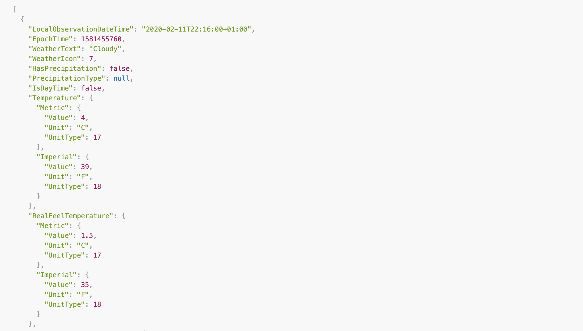
RESTful Response
Fahrenheit and Celsius. Good stuff!

Slide 10
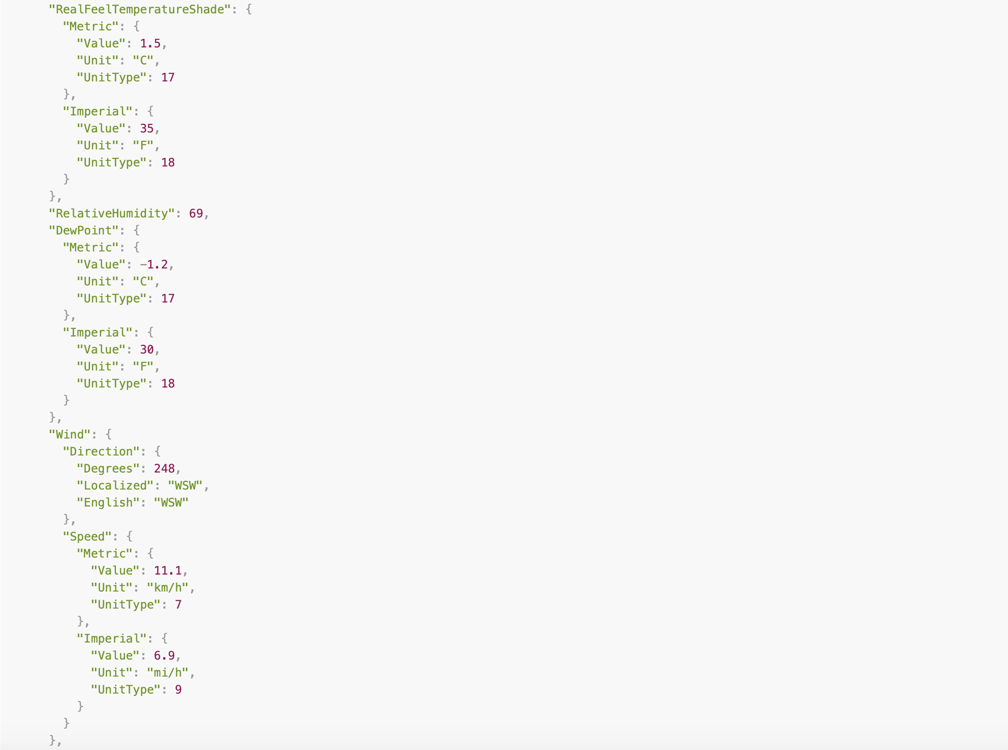
RESTful Response
Humidity and wind speed… umm…
Okay…

Slide 11
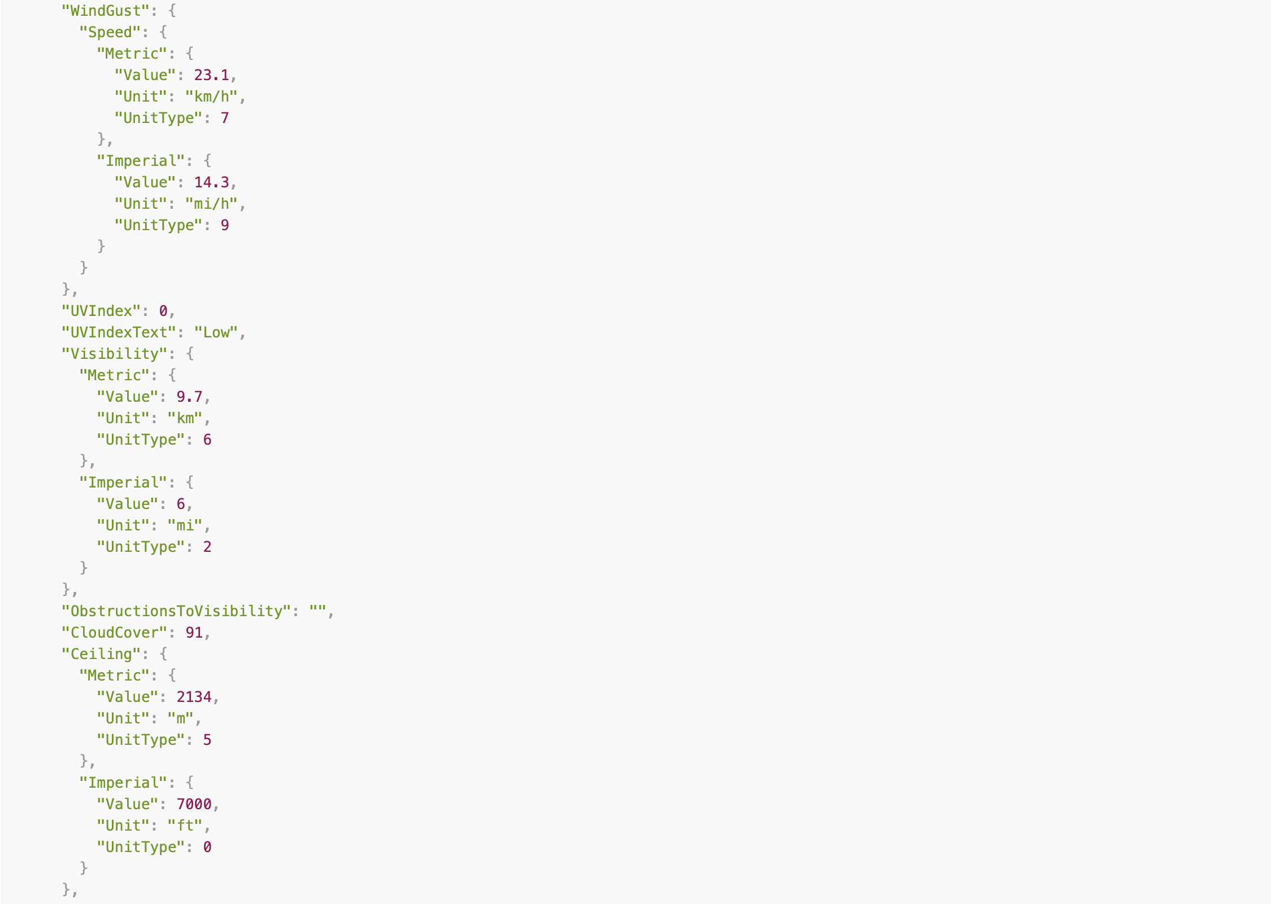
RESTful Response
Wind gusts, UV index, cloud cover? Maybe if I’m going to go kiting at the beach…

Slide 12
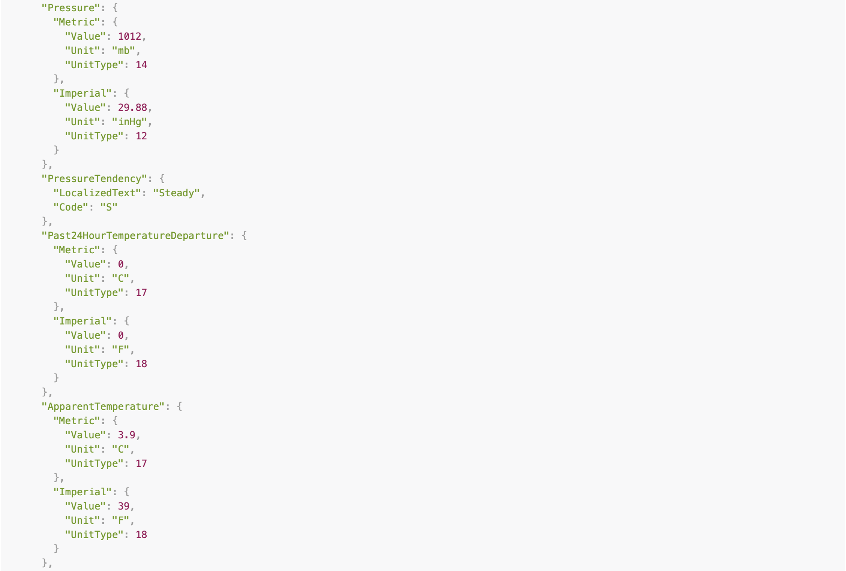
RESTful Response
Pressure tendency, apparent temp?

Slide 13
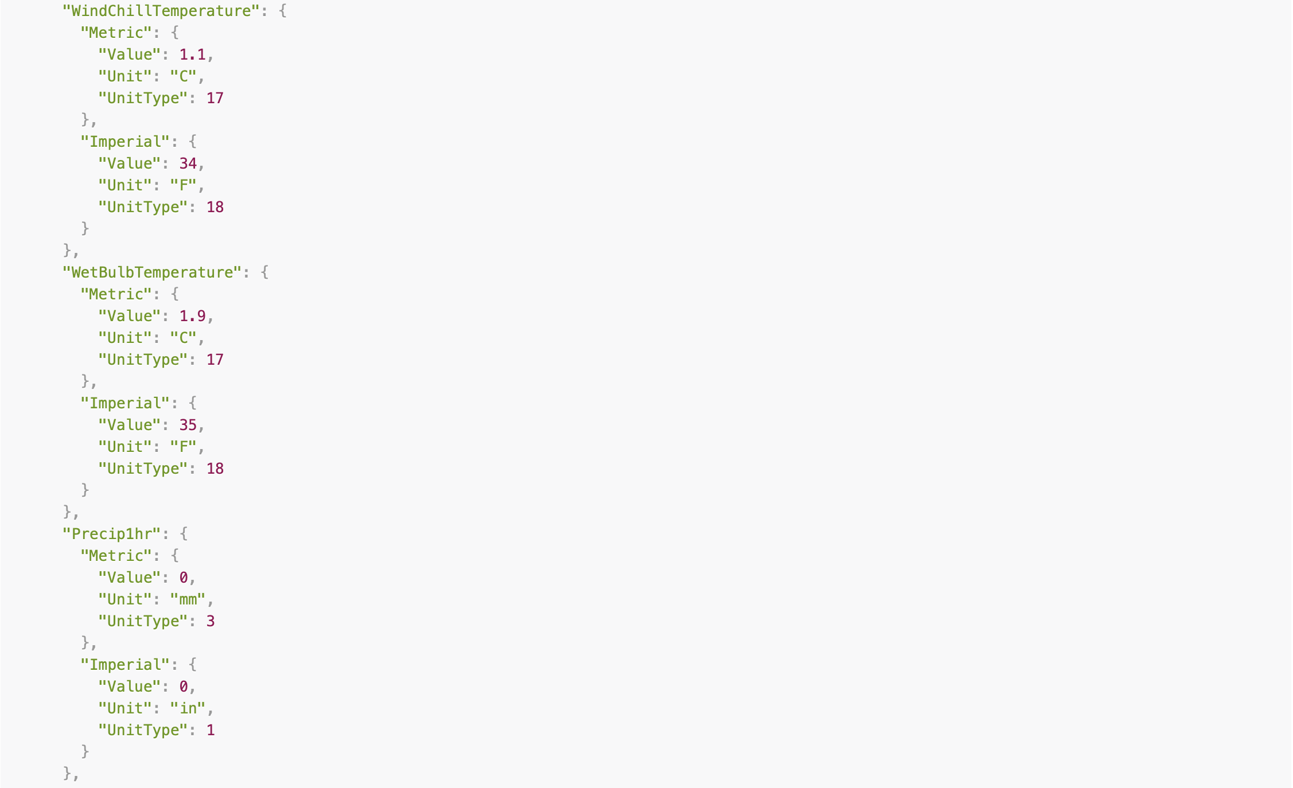
RESTful Response
Wet bulb temperature?? Are we done yet?

Slide 14
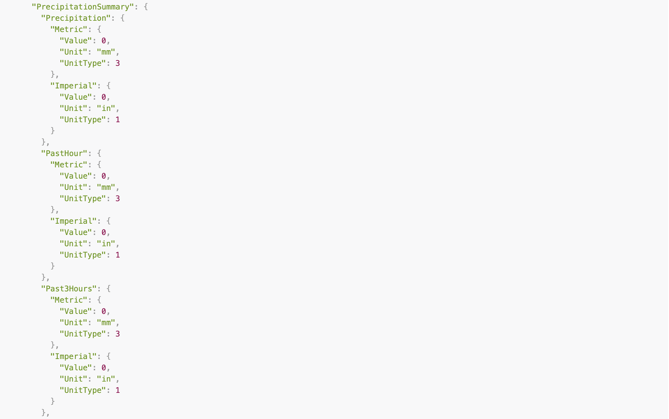
RESTful Response
No, really… Are we done yet?

Slide 15
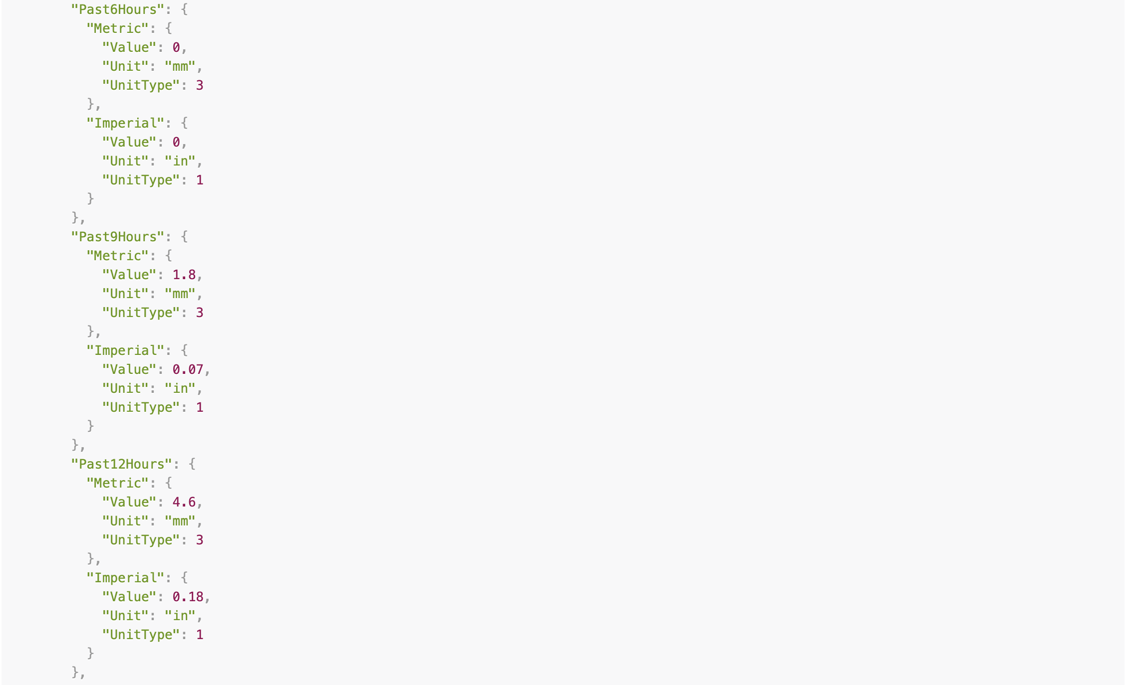
RESTful Response
Do we really need to know the precipitation from the past 6, 9, and 12 hours?

Slide 16
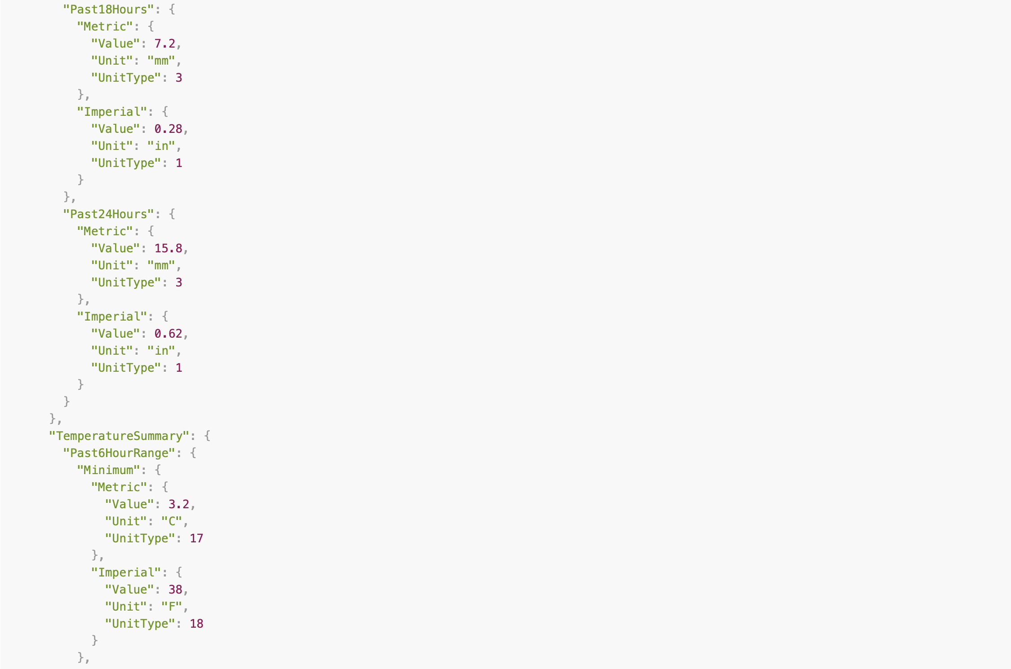
RESTful Response
Oh dear… There’s still more…

Slide 17
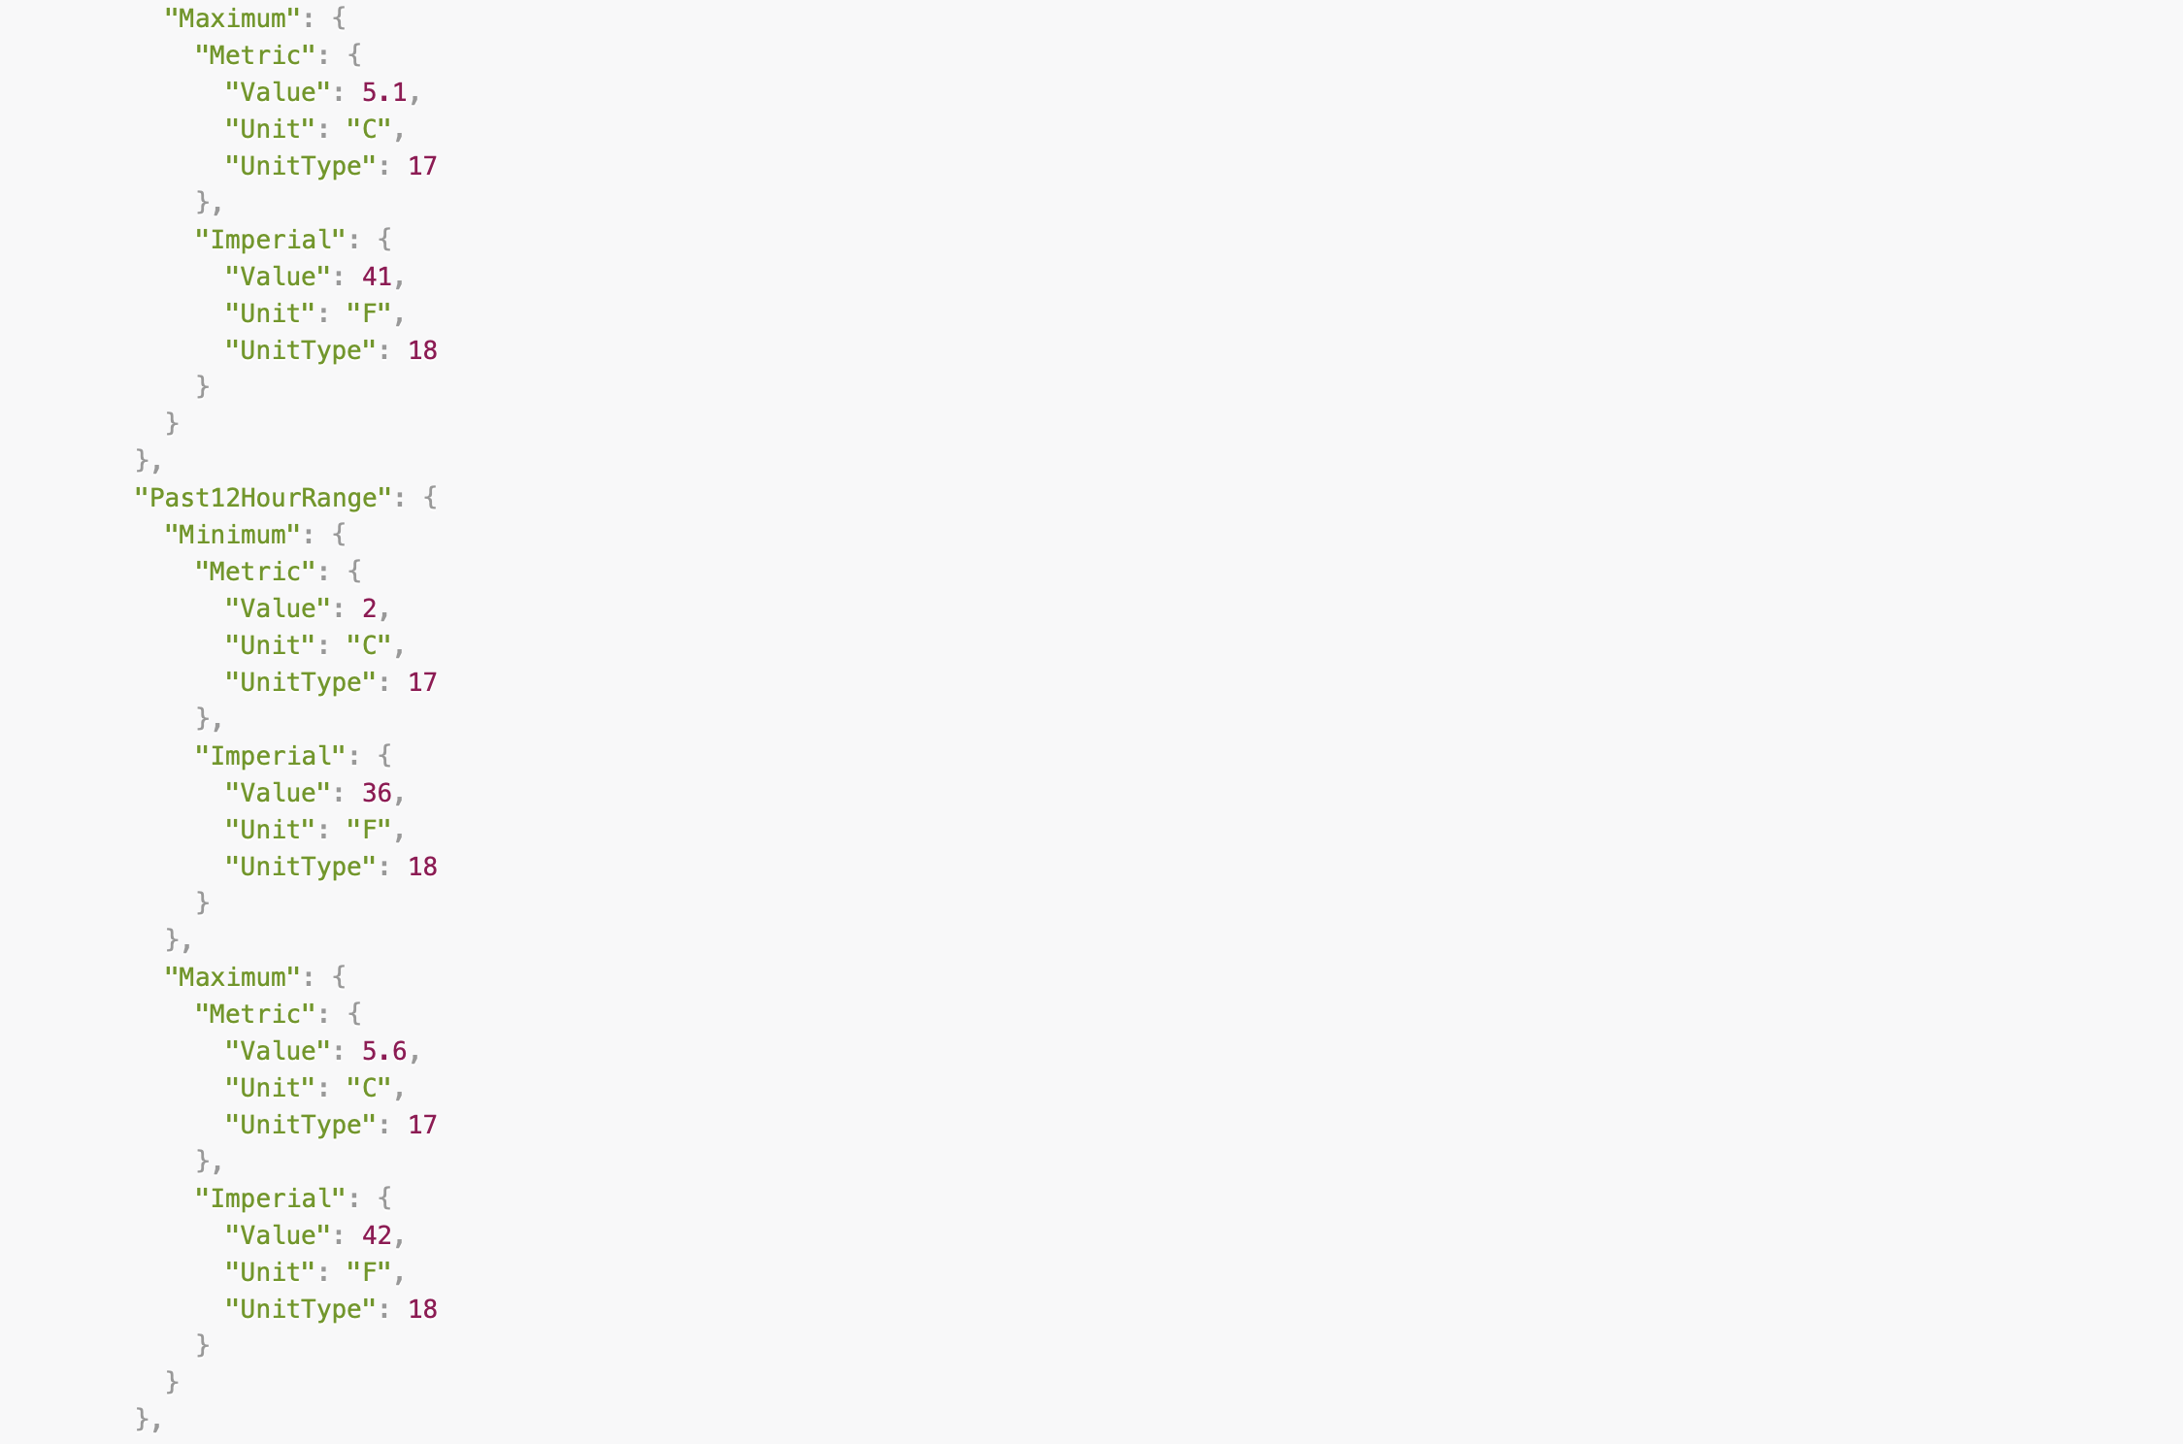
RESTful Response
Help! I’m drowning in weather data!!

Slide 18
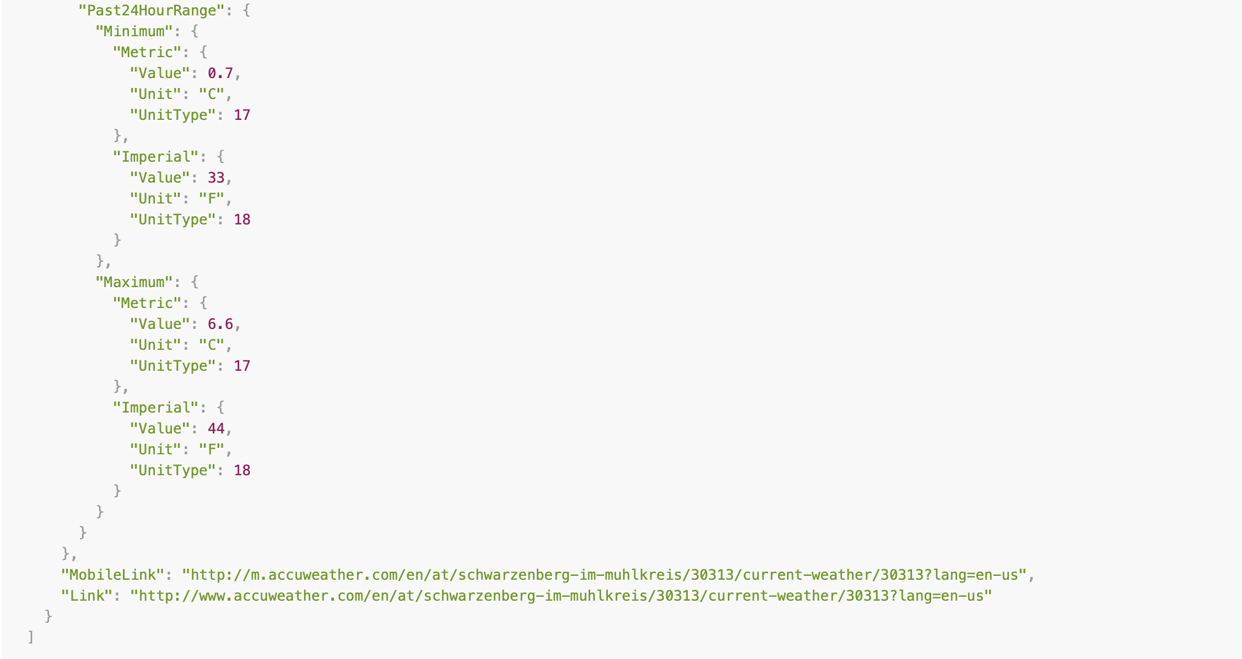
RESTful Response
Is this the end?? Could it be?!

Slide 19
RESTful Response
No, just kidding. We’re really done now. ;-)
This is what we call OVER-FETCHING.
But what if we want to get the current conditions from all of our sites?

Slide 20
Under-Fetching
Under-fetching is when we need to make multiple requests to get the data we want.
So if we need to get the current conditions for three different locations, we would need to make three different REST requests.
Now we get to sift through all that data – times three!!

Slide 21
No Thank You! GraphQL to the rescue!
GraphQL was designed with the idea of reducing over- and under-fetching.
GraphQL queries specify exactly what the client wants.
Multiple queries can be submitted on the same request.

Slide 22
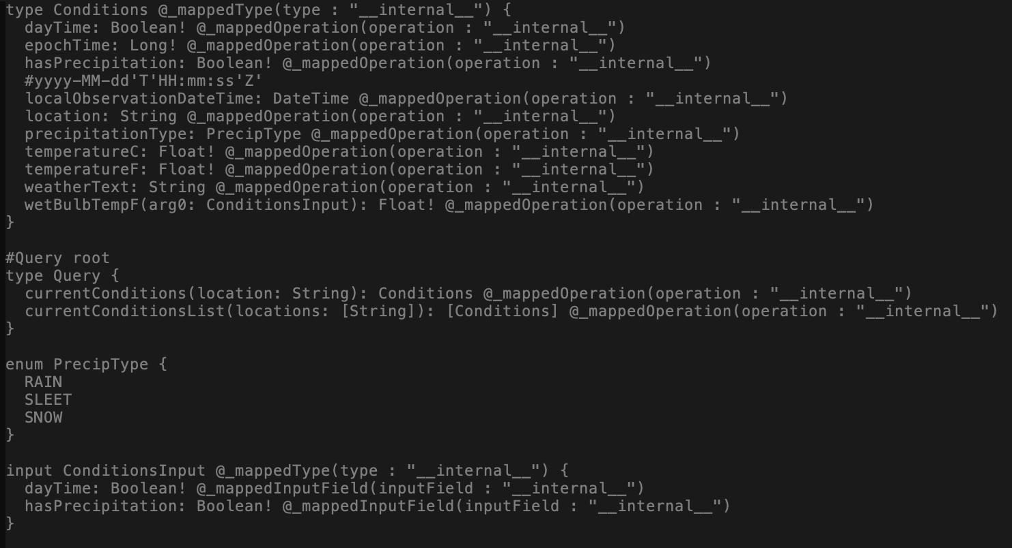
No Thank You! GraphQL to the rescue!
GraphQL was designed with the idea of reducing over- and under-fetching.
GraphQL queries specify exactly what the client wants.
Multiple queries can be submitted on the same request.

Slide 23
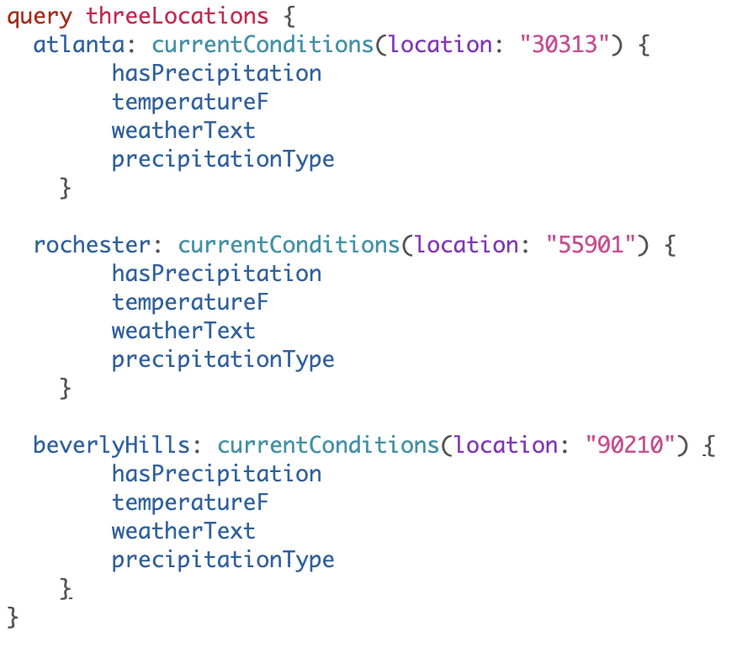
No Thank You! GraphQL to the rescue!
GraphQL was designed with the idea of reducing over- and under-fetching.
GraphQL queries specify exactly what the client wants.
Multiple queries can be submitted on the same request.

Slide 24
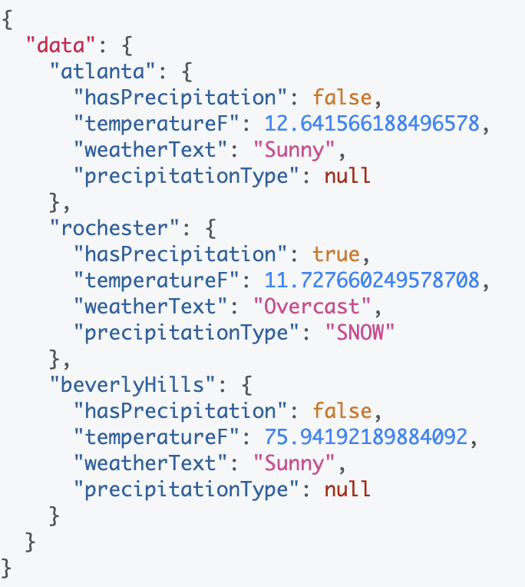
No Thank You! GraphQL to the rescue!
GraphQL was designed with the idea of reducing over- and under-fetching.
GraphQL queries specify exactly what the client wants.
Multiple queries can be submitted on the same request.

Slide 25
Let’s see the code!!

Slide 26
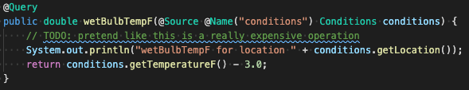
Only load what I want to load
The @Source annotation allows apps to avoid expensive data lookups when the client doesn’t want that data anyway!

Slide 27
Let’s see it work!!

Slide 28
What if we run into an exception?
GraphQL supports partial results.
For multiple queries, the successful results are returned while error data is returned for unsuccessful queries.
Developers can throw a GraphQLException that contains partial results.

Slide 29
Let’s check it out!!

Slide 30
What’s next?
Refinements / Clarifications / Fixes
GraphQL Client APIs
Subscriptions?
Custom Scalars?

Slide 31
Summary
GraphQL fills in some gaps in REST – over-fetching, under-fetching, partial results, etc.
MicroProfile GraphQL makes it easy to develop and deploy GraphQL applications
Open is Awesome!!

Slide 32
Questions?

Slide 33
Links and Coordinates
MP GraphQL: https://github.com/eclipse/microprofile-graphql https://gitter.im/eclipse/microprofile-graphql
Maven Coordinates: <dependency> <groupId>org.eclipse.microprofile.graphql</groupId> <artifactId>microprofile-graphql-api</artifactId> <version>1.0-M6</version> </dependency>
Sample app: https://github.com/OpenLiberty/sample-mp-graphql
GraphQL-SPQR project https://github.com/leangen/graphql-spqr
Andy McCright @AndrewMcCright – j.andrew.mccright@gmail.com – andymc@us.ibm.com

Slide 34
The End

Slide 35
Backup

Slide 36
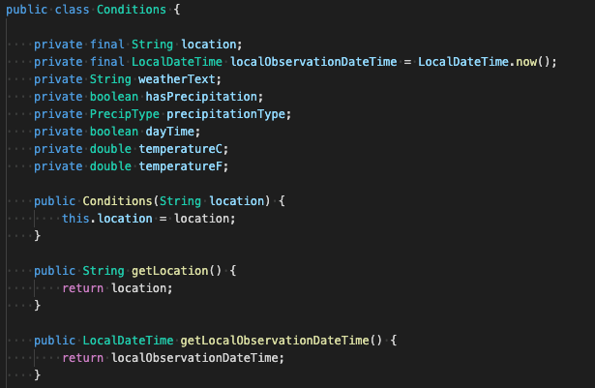
Conditions.java

Slide 37
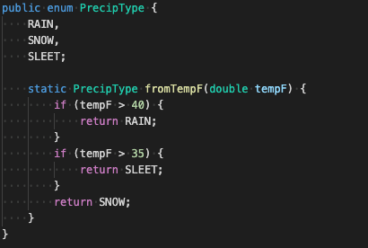
PrecipType.java

Slide 38
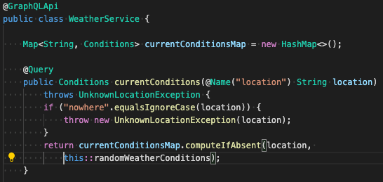
WeatherService.java (part 1)

Slide 39
PrecipType.java

Slide 40
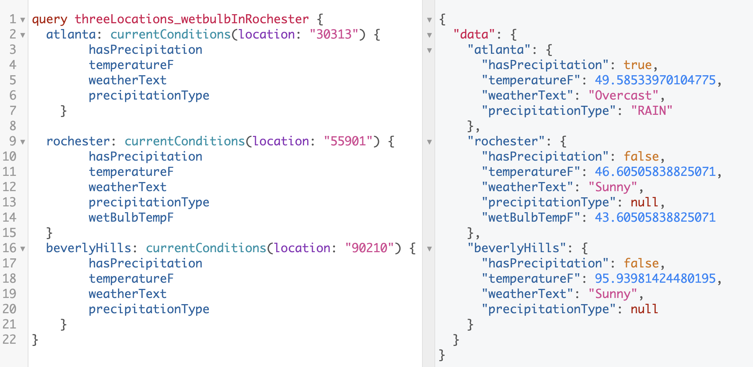
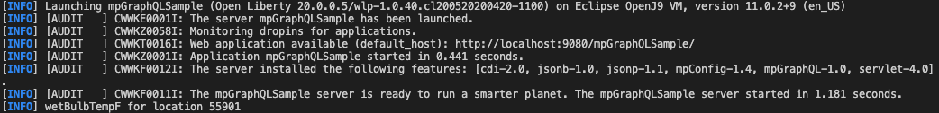
Lookup 3 Cities – WetBulb in Rochester

Slide 41
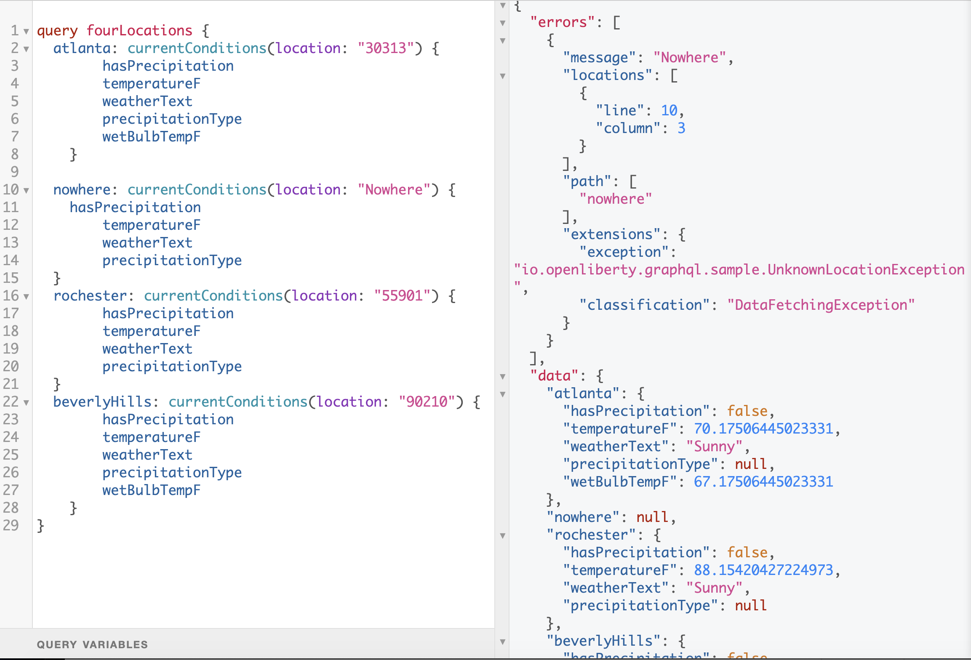
Error Handling Example

